Slide 1
ACHAP contribution to National SMC program
2009 - 2014
ACHAP Phase II Dissemination Workshop
Blessed Monyatsi/Dr. Mwangemi
Gaborone-Botswana.
April, 2015

Slide 2
SMC Targets
Revised National target: 385,000 SMCs for males aged 13 to 49 years
ACHAP contribution – targeted 127,000 SMCs (rev. 112,928) for males 13 to 29 years

Slide 5
SMC Quality of services
WHO AE threshold: 2%

Slide 6
Cost per SMC
Experience and lessons learnt informed changes in SMC staffing structure & implementation methods
These resulted in consistent increases in annual numbers achieved and significant decreases in per SMC costs.
Costs were computed based on total objective specific costs & a proportional amount of overall indirect and program management costs.

Slide 7
Average SMC Costs & SMC Staff Complement

Slide 8
SMC Success attributes
Improved planning for the community campaigns, with involvement of all district stakeholders, improved DHMT/MOH program ownership
Further improvement in relating with MOESD, PTAs
Targeted outreaches with greater involvement of community leaders
Stable availability of supplies, improved logistical support
Operational re-structuring – improved access to resources, program/technical support

Slide 9
a. SMC Service delivery
Bulk of SMC’s have been through Outreach activities
Increase in delivery capacity and team efficiency during campaigns, 40- 50 SMCs /day by modified MOVE teams
Quarterly bonus for clinical teams when they exceed 90% of the targets
Use of diathermy machines for haemostasis
Increased HR support by some DHMTs during campaigns

Slide 10
b. SMC Campaign Approach
The use of school break and outreach campaigns were highly influential in creating higher SMC demand and delivering on that demand through increased service delivery capacity.

Slide 11
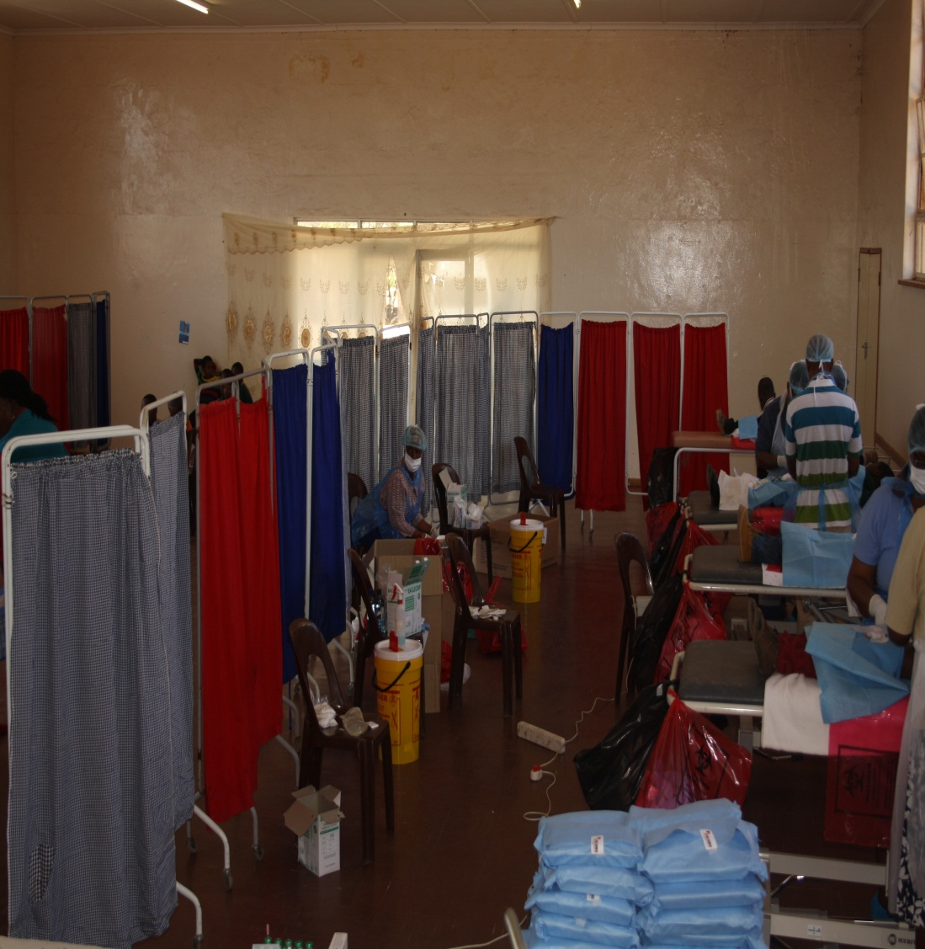
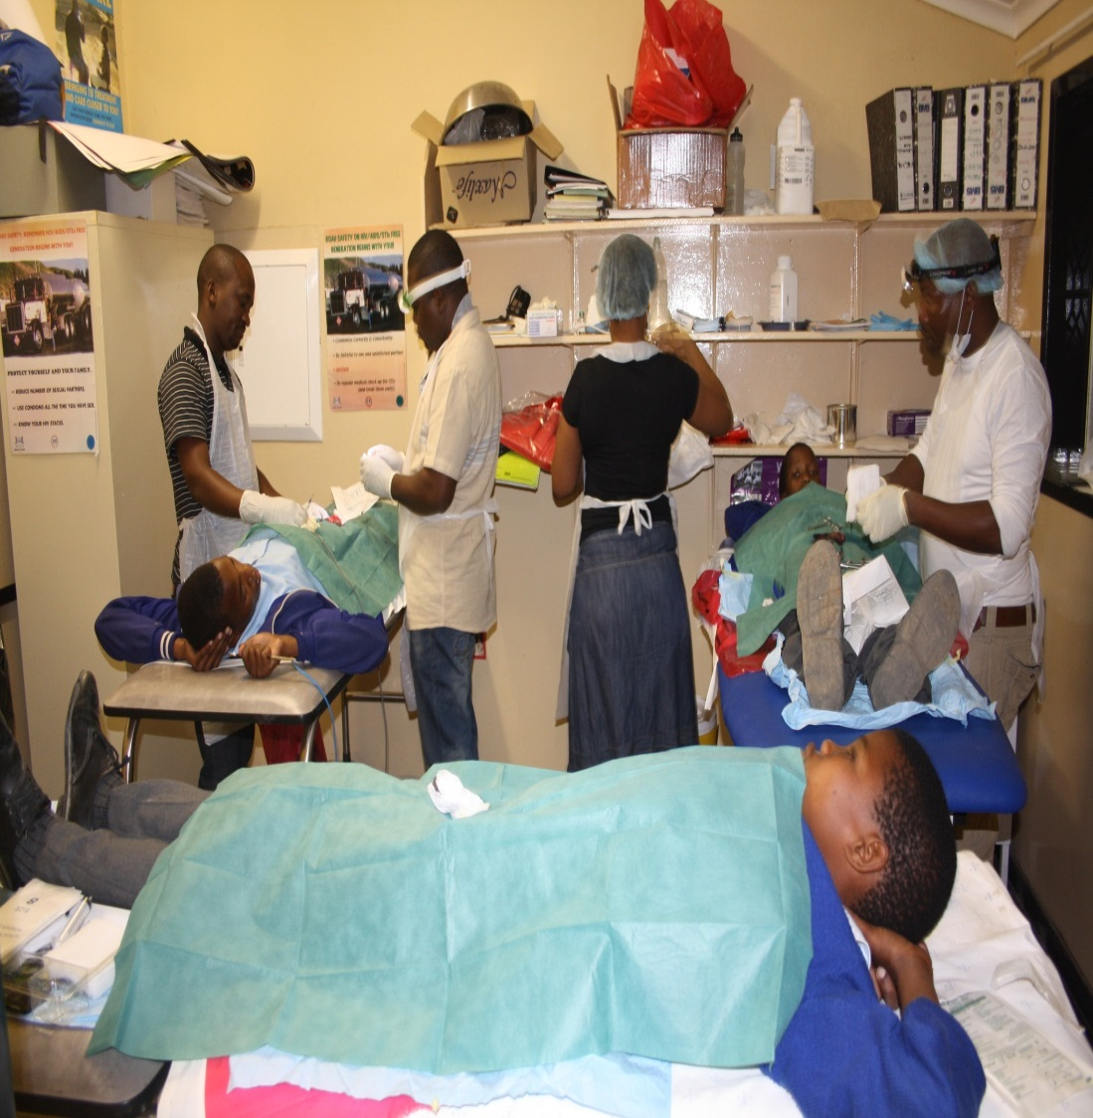
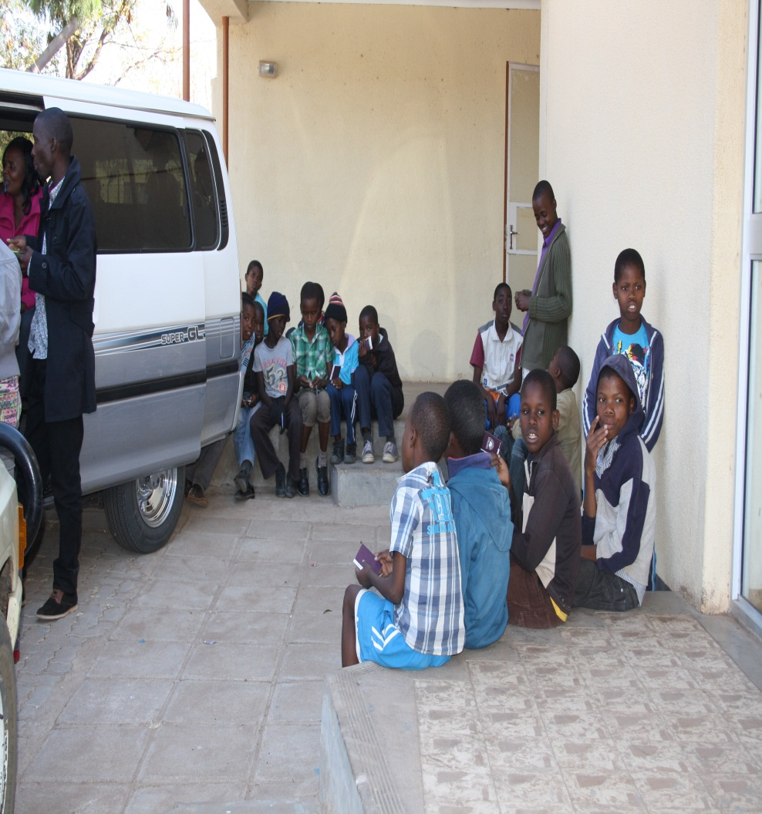
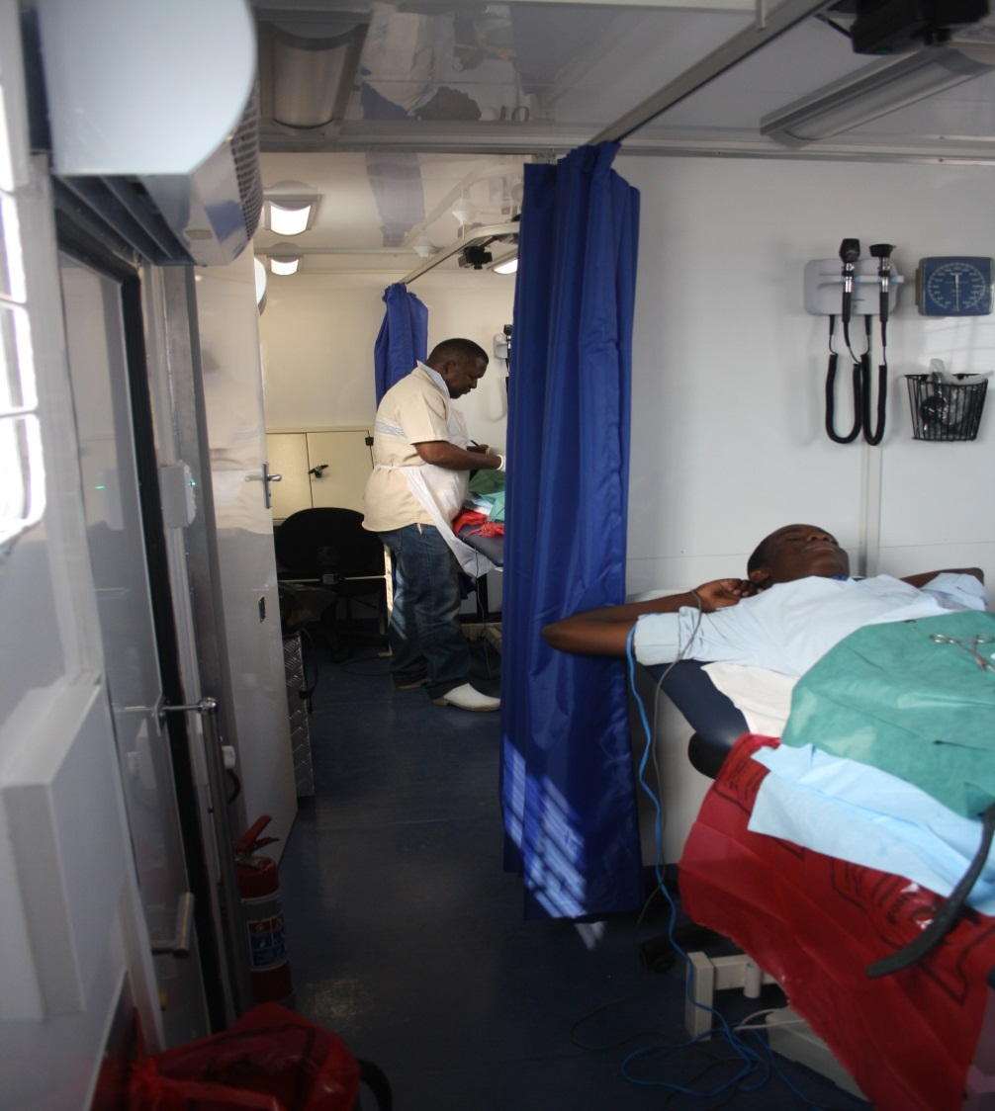
Mini-School campaign

Slide 12
c. Space and supplies
Space :
Availability of space for SMC procedures – clean classrooms, social halls, use of tents, porta-cabins
Supplies:
Timely adequate and diligent planning for the SMC activities
Procurement of supplementary supplies to ensure consistent availability

Slide 13
d. SMC Demand creation
Performance based compensation of mobilisers
Increased involvement of district and community level stakeholders leading to improved planning of outreach activities and campaigns
Targeted messaging and increased emphasis on other SMC benefits
Mapping and defining catchment areas for each SMC clinical team
Increased advocacy by community leadership

Slide 14
SMC Demand creation cont’d
Internal benchmarking visits among ACHAP teams & sharing of demand creation approaches helping improve performance
Increased involvement of the clinical teams in demand creation planning and implementation
Increased availability of client educational materials
Evaluation of demand creation approaches – and adopting best practices

Slide 15
